Slide 1


What is the reach and what are the boundaries of health and social care research?
A few observations from a health economist…
Professor Rhiannon Tudor Edwards
Centre for Health Economics and Medicines Evaluation (CHEME)

Slide 2
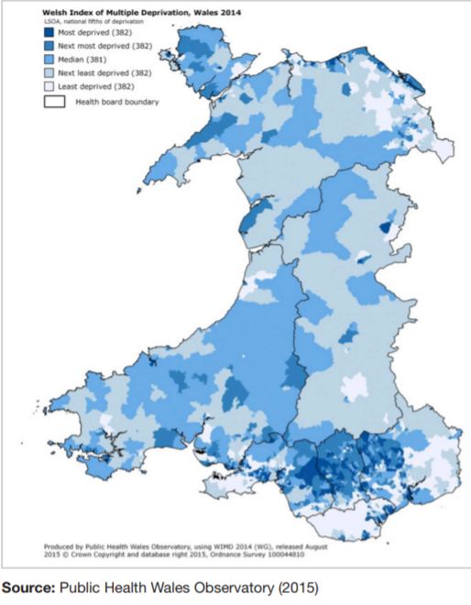
Inequality across Wales
One in three children are living in child poverty in Wales.
At birth there is an 18.9 - year difference in healthy life expectancy between the least and most deprived area of Wales.

Slide 3
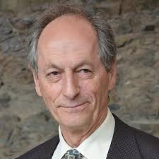
Fair Society, Healthy Lives - The Marmot Review
Reducing health inequalities will require action on six policy objectives:
1. Give every child the best start in life
2. Enable all children young people and adults to maximise their capabilities and have control over their lives
3. Create fair employment and good work for all
4. Ensure healthy standard of living for all
5. Create and develop healthy and sustainable places and communities
6. Strengthen the role and impact of ill health prevention
Professor Sir Michael Marmot

Slide 4
Vision – Health and Care Research Wales
For Wales to be internationally recognised for its
excellent health and social care research that has a positive impact
on the health, wellbeing and prosperity of the people in Wales.

Slide 5
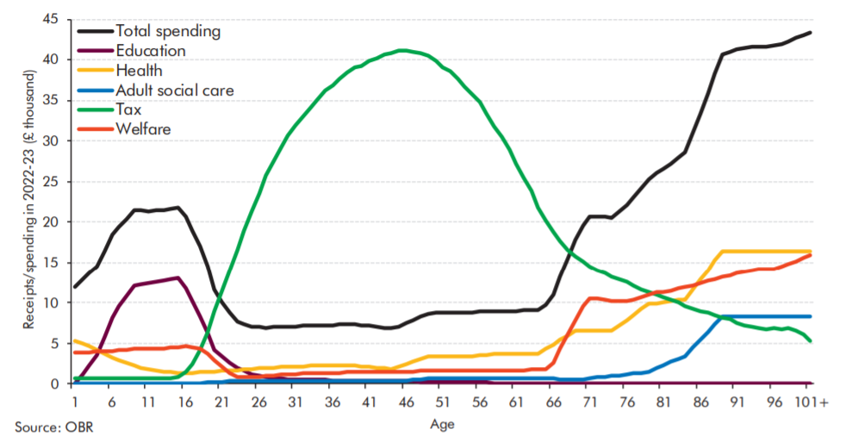
Public spending and tax revenue through the life-course
Public spending in relation to age
Source: OBR (2018), Fiscal sustainability report. Available at: http://cdn.obr.uk/FSR-July-2018-1.pdf

Slide 6
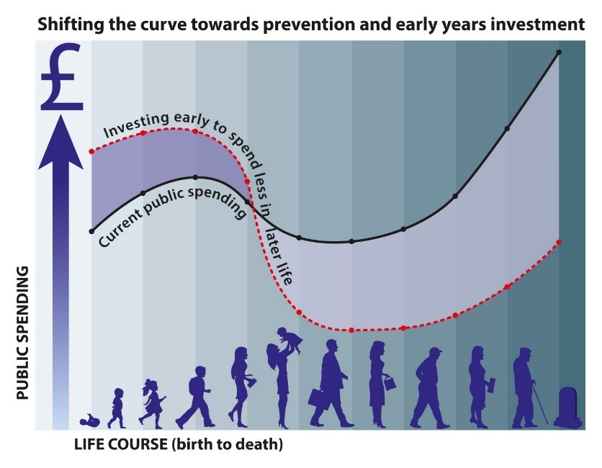

Slide 7
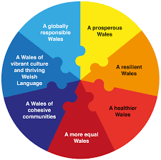
Wales -Wellbeing of Future Generations Act
The Well-being of Future Generations Act gives us the ambition, permission and legal obligation to improve our social, cultural, environmental and economic well-being.

Slide 8
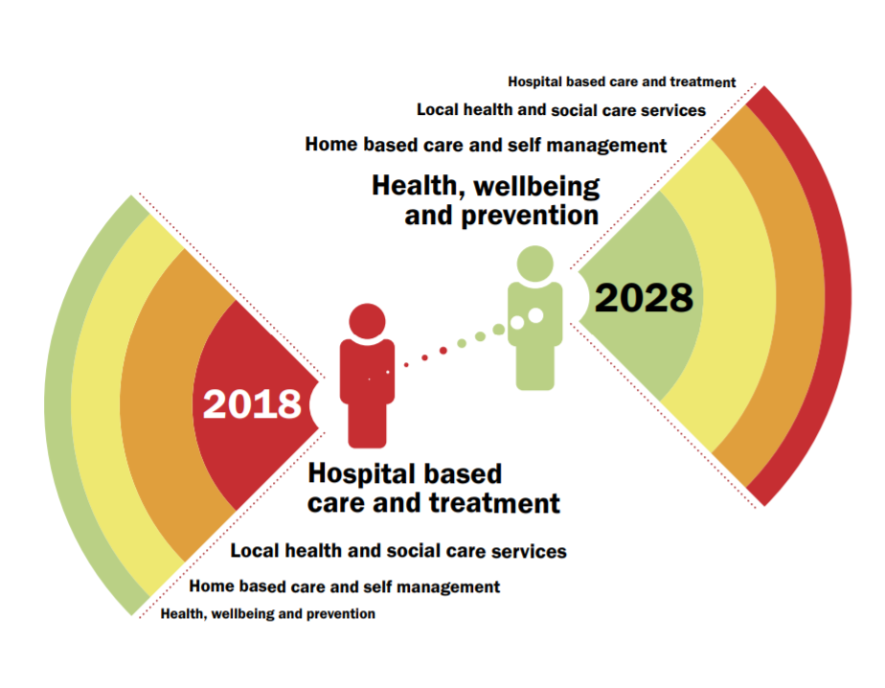
A Healthier Wales: our Plan for Health and Social Care
Plan sets out a long term future vision of a ‘whole system approach to health and social care’, which is focussed on health and wellbeing, and on preventing illness.
Source: Welsh Government (2018). A Healthier Wales: our Plan for Health and Social Care.
Available at: https://gov.wales/docs/dhss/publications/180608healthier-wales-mainen.pdf

Slide 9
Prosperity for All
Prosperity is not just about material wealth – it is about every one of us having a good quality of life, and living in strong, safe communities.
4 keys themes:
Prosperous and Secure
Healthy and Active
Ambitious and Learning
United and Connected
Source: Welsh Government (2017). Prosperity for All: the national strategy. Available at: https://gov.wales/docs/strategies/170919-prosperity-for-all-en.pdf

Slide 10


Early years

Slide 11


Older people

Slide 12


Codi’r To

Slide 13
Definitions
It is important to consider the following as guidelines and not a definition of social care research. It is inevitable that some research projects, especially those conducted at the interface of social care and health, will be difficult to categorise as clearly belonging to one category or the other.
Health and Care Research Wales Social Care Research Guidelines
Dan Venables document supported by Fiona Verity

Slide 14

Expanding our research partners across the life-course
Examples…
Public Health Wales
The education sector
Local government
Charities
Department of Work and Pensions
Police, fire services and judicial system

Slide 15



To contact me:
Professor Rhiannon Tudor Edwards r.t.edwards@bangor.ac.uk
@ProfRTEdwards @CHEMEBangor
44 0 7799460347
Centre for Health Economics & Medicines Evaluation (CHEME)
Bangor University, Ardudwy Hall, Normal Site, Gwynedd, LL57 2PZ
E-mail: cheme@bangor.ac.uk

